Slide 1
CSC 326 Final Project

Slide 2
Agenda
Part 1: Sebastian Moran Original and Improved Bubble Sort Heap Sort
Part 2: Junyao Han Selection Sort and MinMax Selection Sort Merge Sort and Merge-Insertion Sort
Part 3: Ibrahim Insertion Sort Quick Sort
Part 4: Graphical Comparison Comparison Amongst All Sorting Algorithms
Appendix: Data from Project

Slide 3
Part 1: Bubble and Heap Sort

Slide 4
Bubble Sort
int bubbleSort(int b[], int n) {
int k = 0;
k++;
k++;
for (int i = 0; i < n-1; i++) {
k+=3;
for (int j = 0; j < n - i - 1; j++) {
k+=3;
if (b[j] > b[j+1]) {
swap(b[j], b[j+1]);
k+=3;
}
}
}
return k;
}
Best case: O(n²)
Average case: O(n²)
Worst case: O(n²)

Slide 5
Improved Bubble Sort
int bubbleSort(int b[], int n) {
int k = 0;
k++;
k++;
bool swapped;
for (int i = 0; i < n-1; i++) {
swapped = false;
k+=4;
for (int j = 0; j <n - i - 1; j++) {
k+=3;
if (b[j] > b[j+1]) {
swap(b[j], b[j+1]);
//numSwaps++;
swapped = true;
k+=4;
}
}
if (swapped == false) {
k++;
break;
}
}
return k;
}
Best case: O(n)
Average case: O(n²)
Worst case: O(n²)

Slide 6
void Heapify(int A[], int i, int n, int &k){
int child;
k+=2;//
if (2*i + 1> n-1)
return;
else
child = 2*i+1;
if (2*i +2 <= n-1) {
k++;
if (A[child] < A[child+1]) {
child++;
k++;
}
}
k++;
if (A[i] < A[child]) {
k+=3; // swap takes three steps
swap(A[i], A[child]);
Heapify(A, child, n, k);
}
k++;
}
Heap Sort

Slide 7
void buildHeap (int A[], int n, int &k) {
k++;
for (int i = n/2; i > 0; i--) {
k+=3;
Heapify(A, i-1, n, k);
}
}
int heapSort (int A[], int n) {
int k = 0;
buildHeap(A, n, k);
k+=2;
for (int i = n; i >= 1; i--) {
swap(A[0], A[i-1]);
Heapify(A, 0, i-1, k);
k+=6;
}
return k;
}
Heap Sort
Continued
Best case: O(n log n)
Average case: O(n log n)
Worst case: O(n log n)

Slide 8
Part 2: Selection and Merge Sort

Slide 9
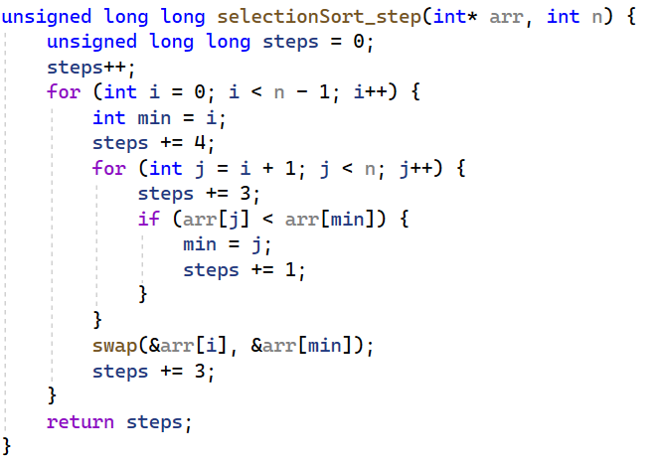
Selection Sort
Best Case Time Complexity is: O(N^2)
Average Case Time Complexity is: O(N^2)
Worst Case Time Complexity is: O(N^2)

Slide 10
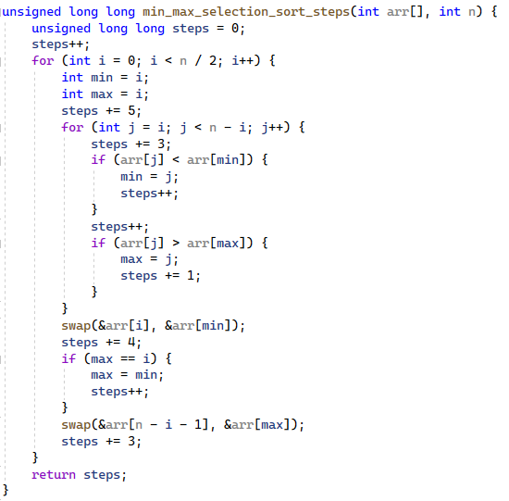
MinMaxSelection
Best Case Time Complexity is: O(N^2)
Average Case Time Complexity is: O(N^2)
Worst Case Time Complexity is: O(N^2)

Slide 11
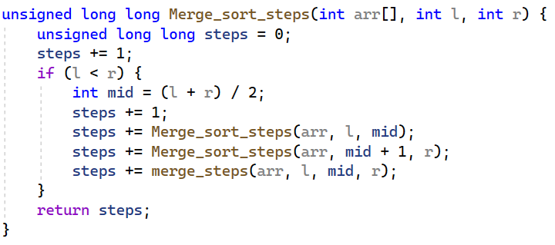
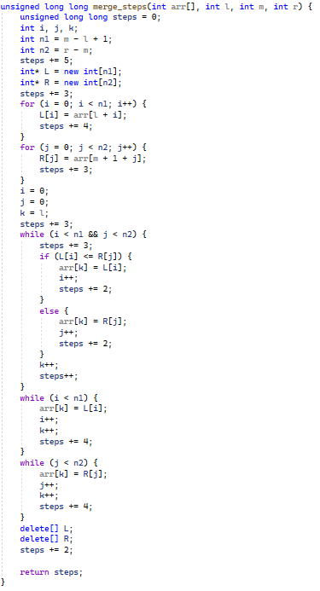
Merge Sort
Best case: O(n log n)
Average case: O(n log n)
Worst case: O(n log n)

Slide 12
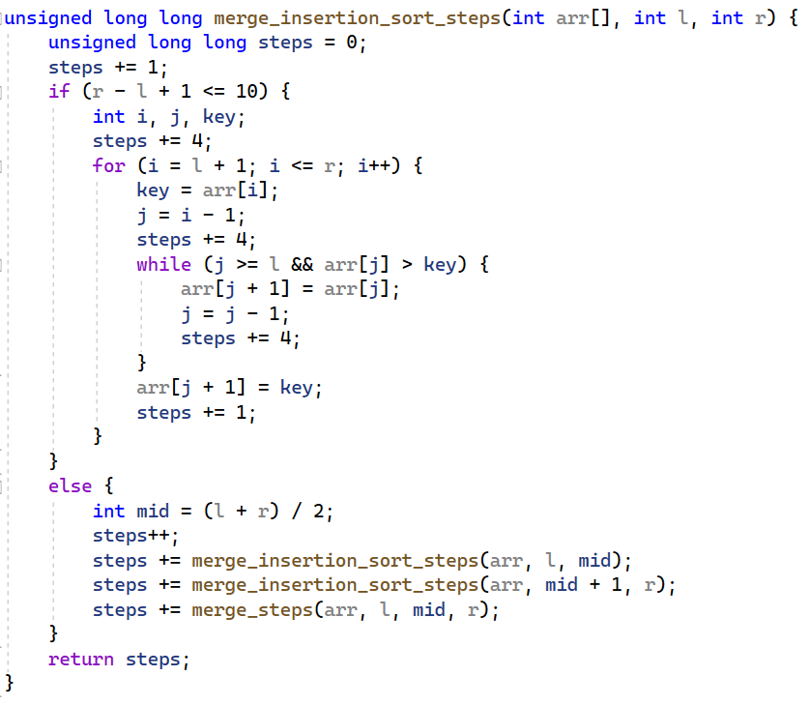
Merge-Insertion Sort
Best case: O(n log n)
Average case: O(n log n)
Worst case: O(n log n)

Slide 13
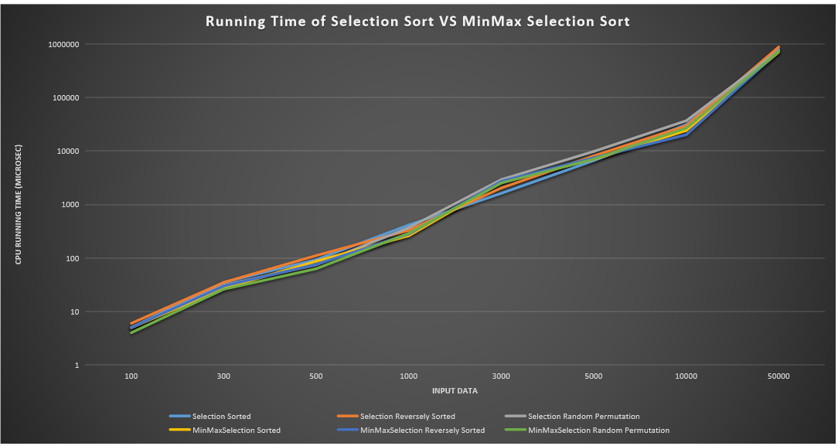
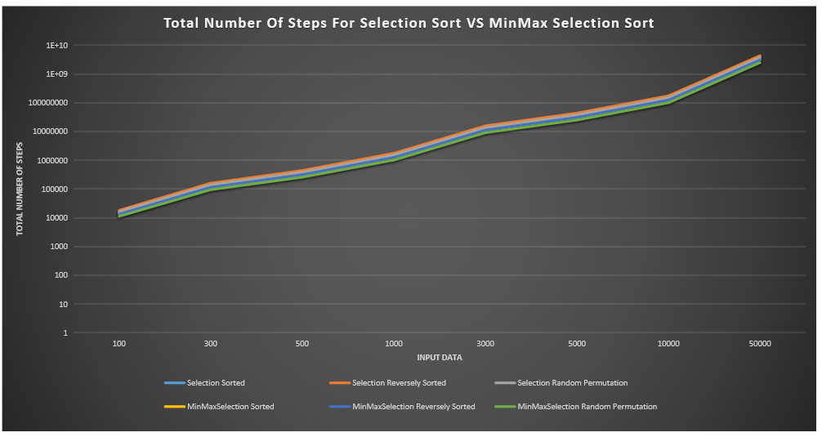
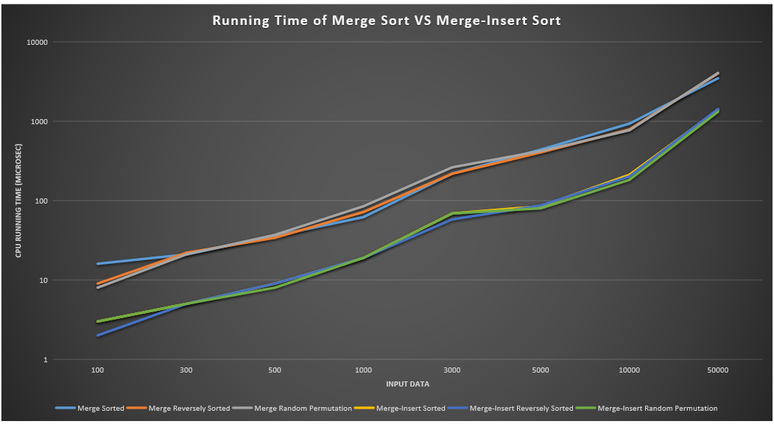
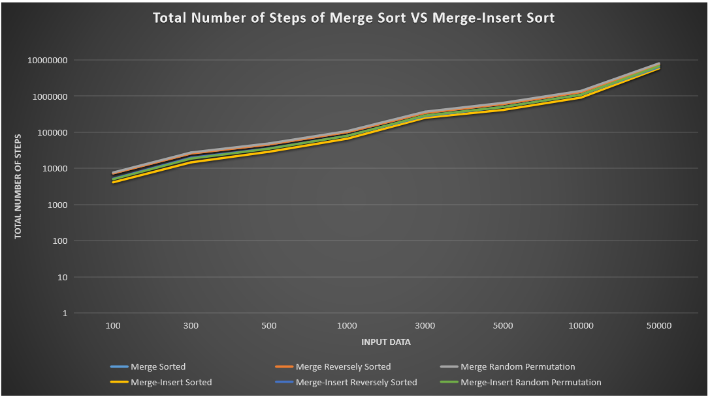

Slide 14
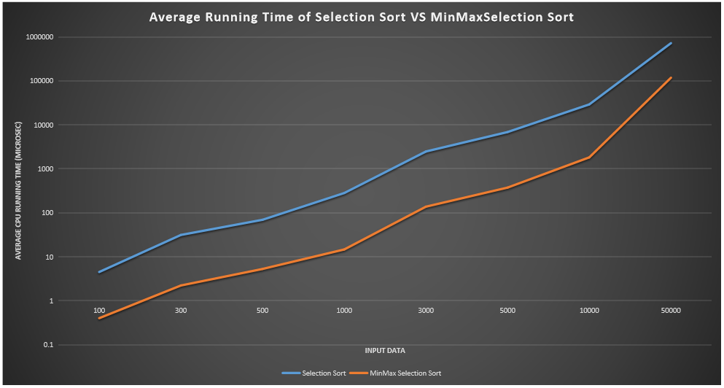
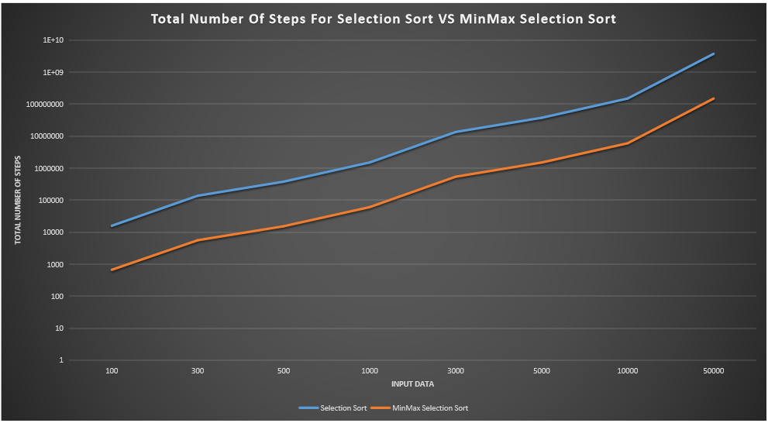
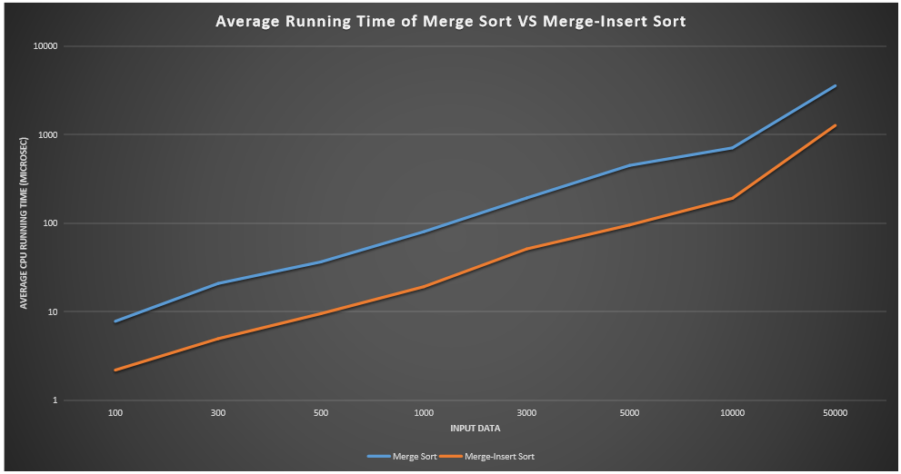
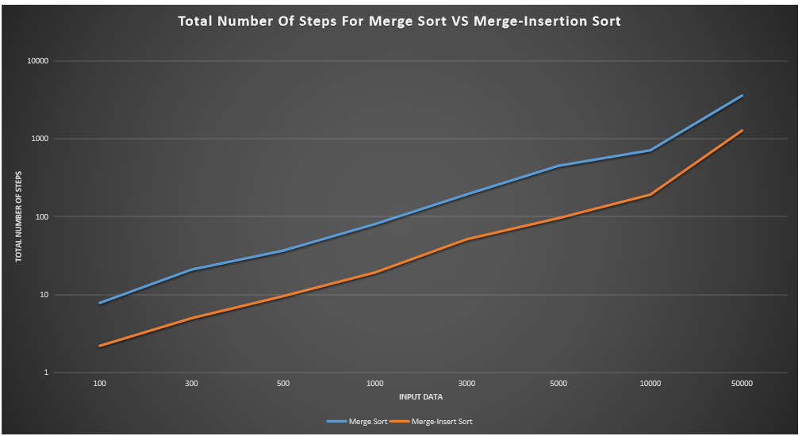

Slide 15
Part 2: Insertion and Quick Sort

Slide 16
int partition(int arr[], int low, int high, int& steps) {
int pivot = arr[high];
int i = low - 1;
for (int j = low; j <= high - 1; j++) {
if (arr[j] < pivot) {
i++;
swap(arr[i], arr[j]);
steps++;
}
}
swap(arr[i + 1], arr[high]);
steps++;
return (i + 1);
}
Quick Sort

Slide 17
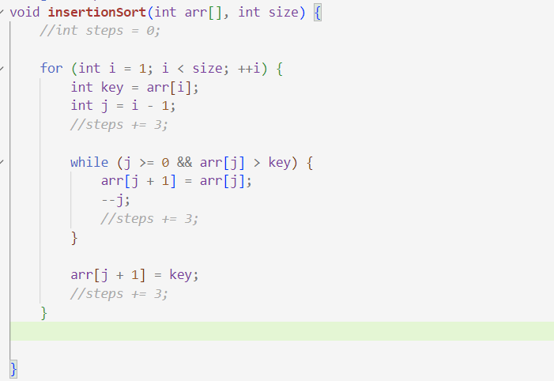
Insertion Sort

Slide 18
void quicksort(int arr[], int low, int high, int& steps) {
if (low < high) {
int pi = partition(arr, low, high, steps);
quicksort(arr, low, pi - 1, steps);
quicksort(arr, pi + 1, high, steps);
}
}
Quick Sort Continued
Best case: O(n log n)
Average case: O(n log n)
Worst case: O(n²)

Slide 19
Part 4: Comparing All Sorting Algorithms

Slide 20
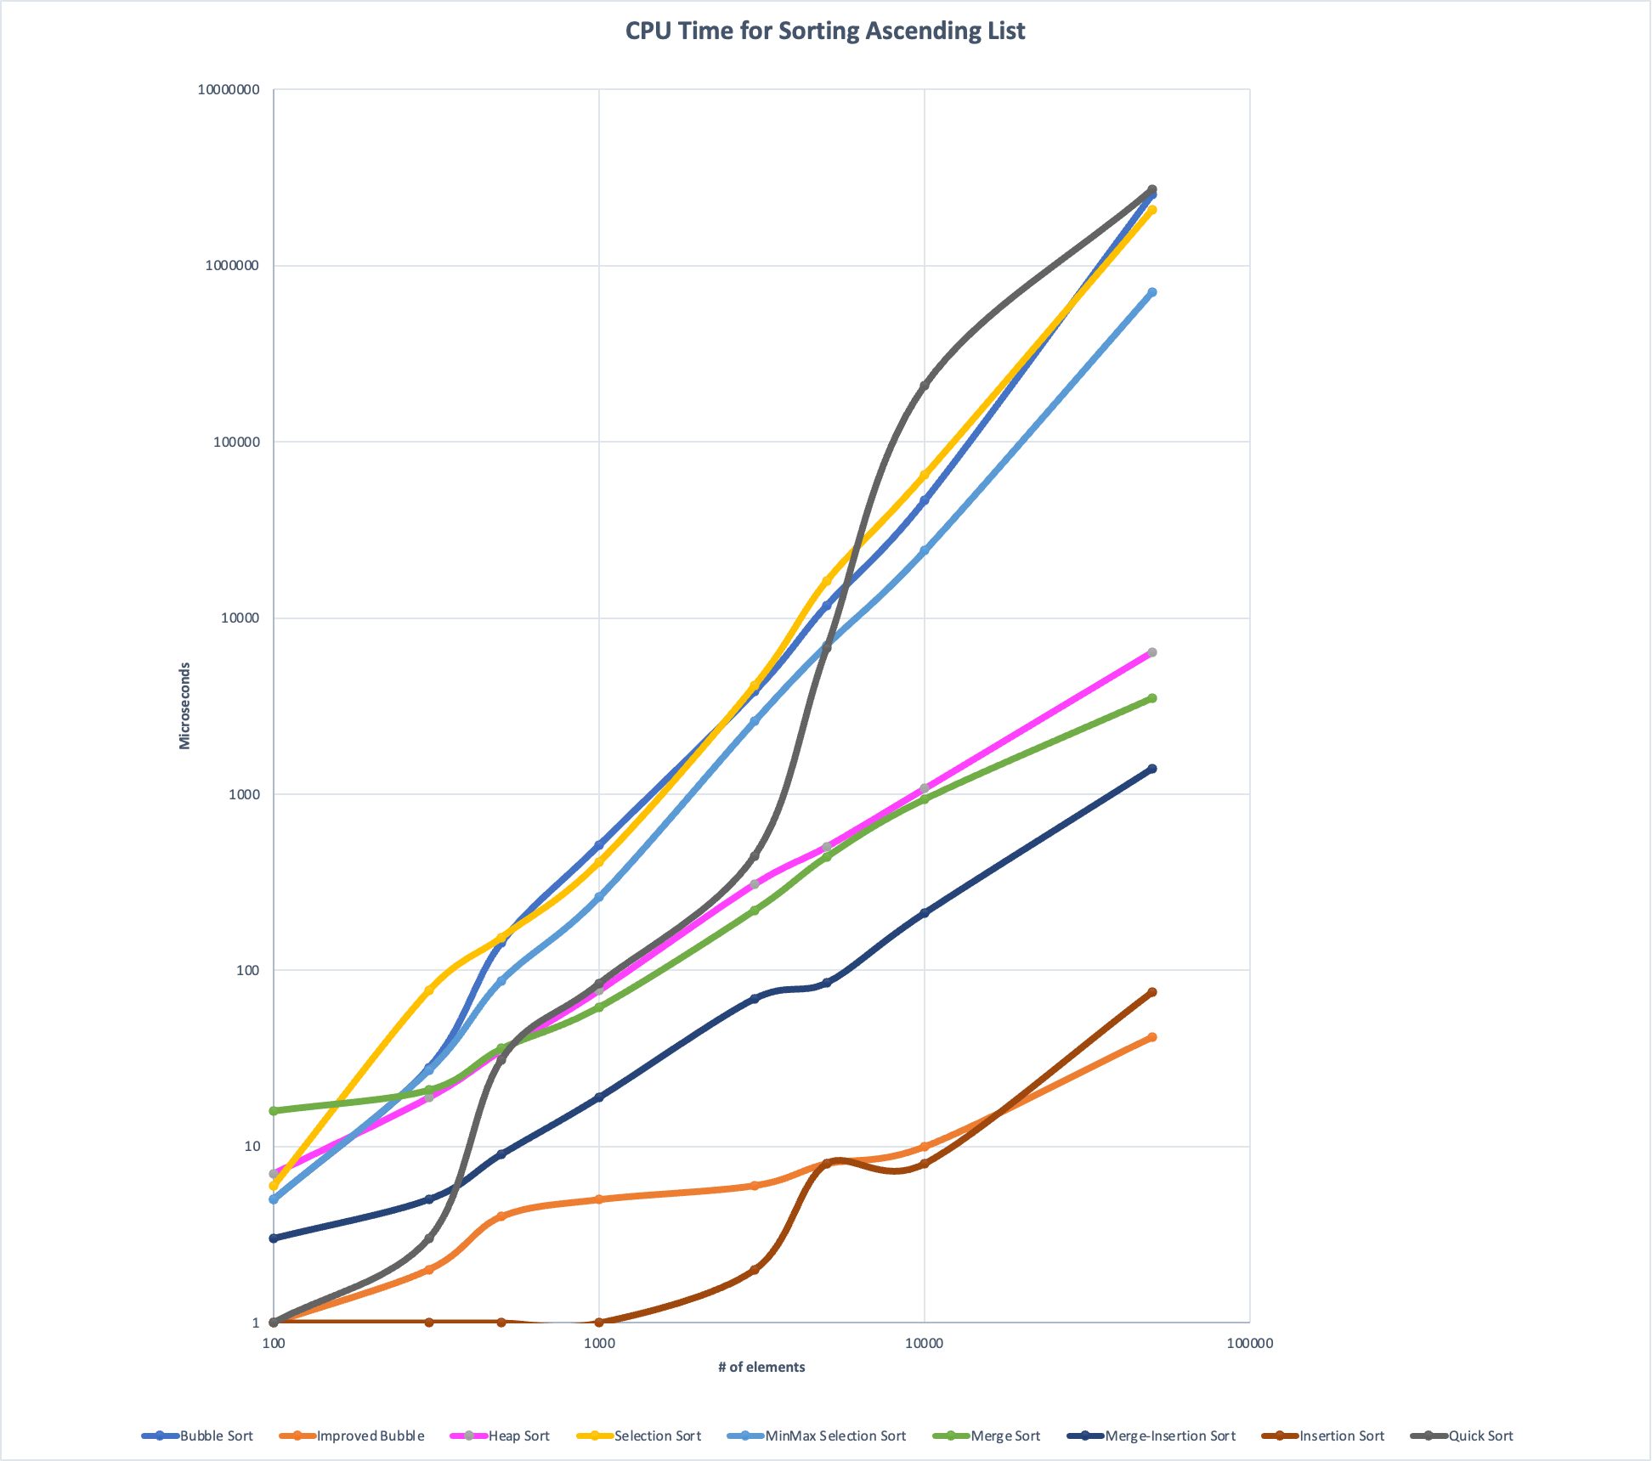
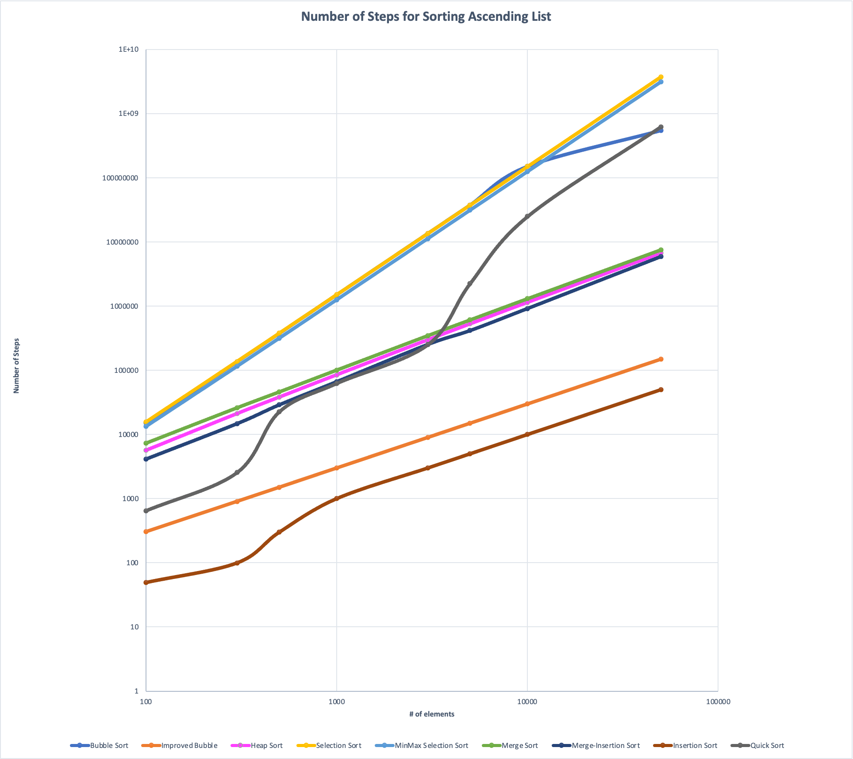
Task 1: Ascending List

Slide 21
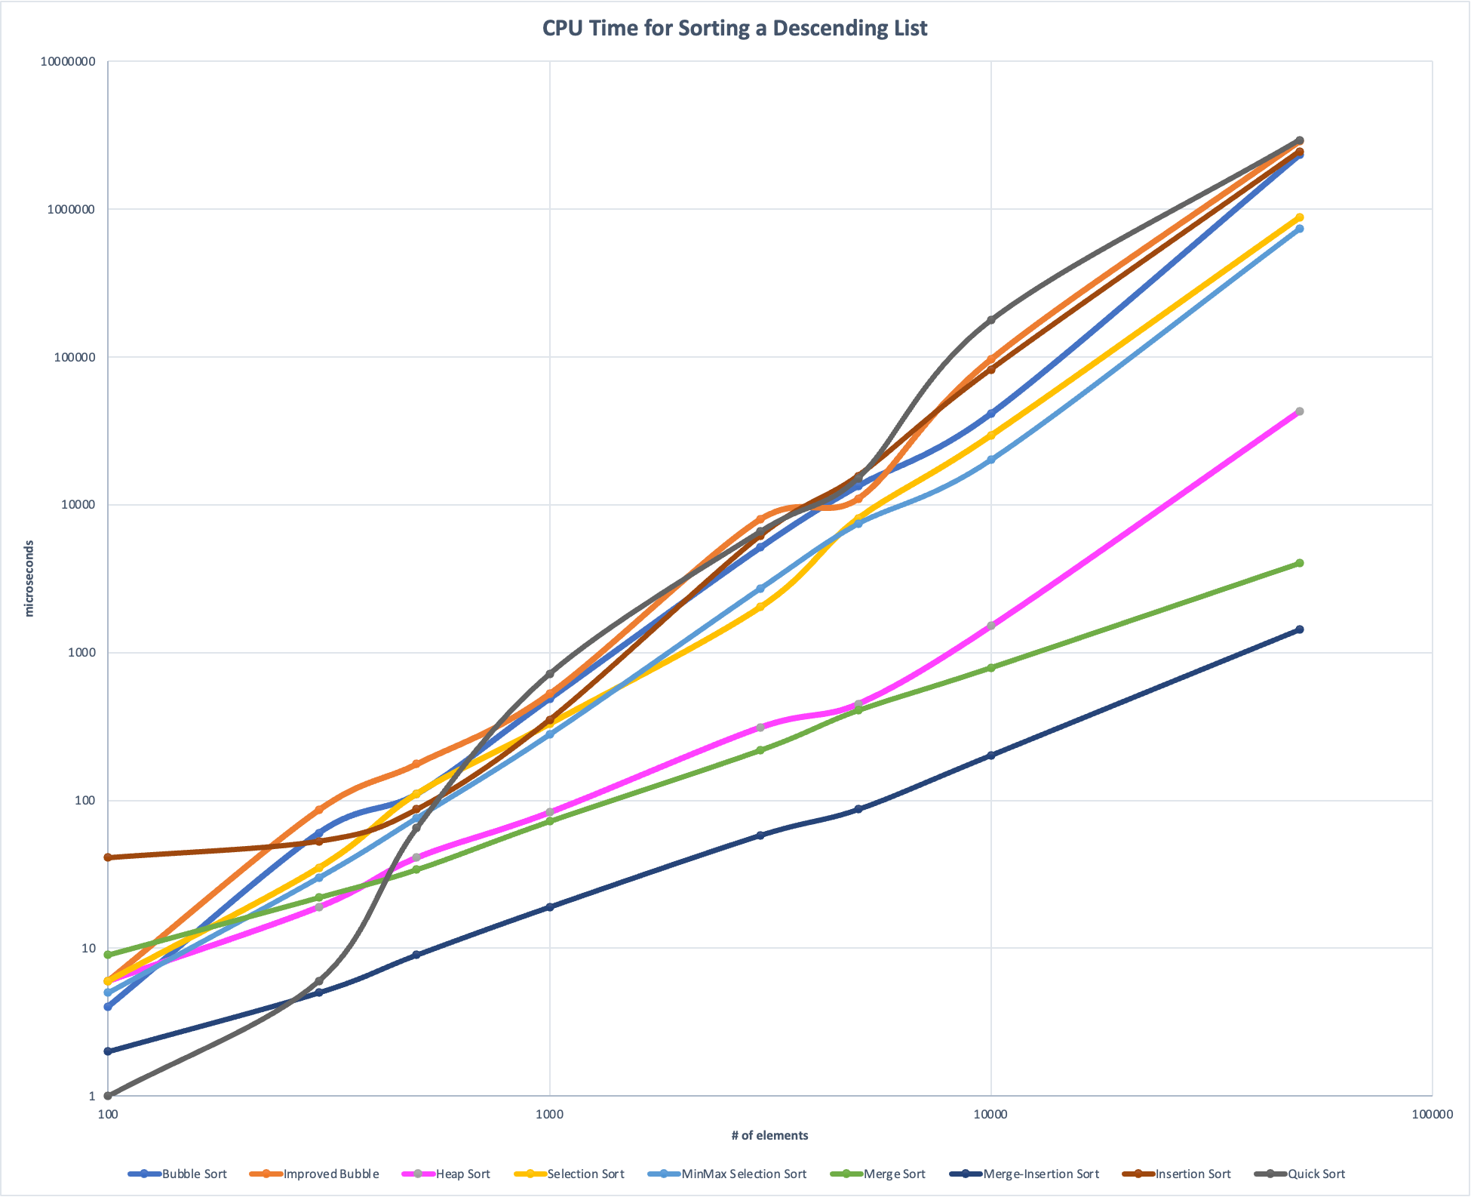
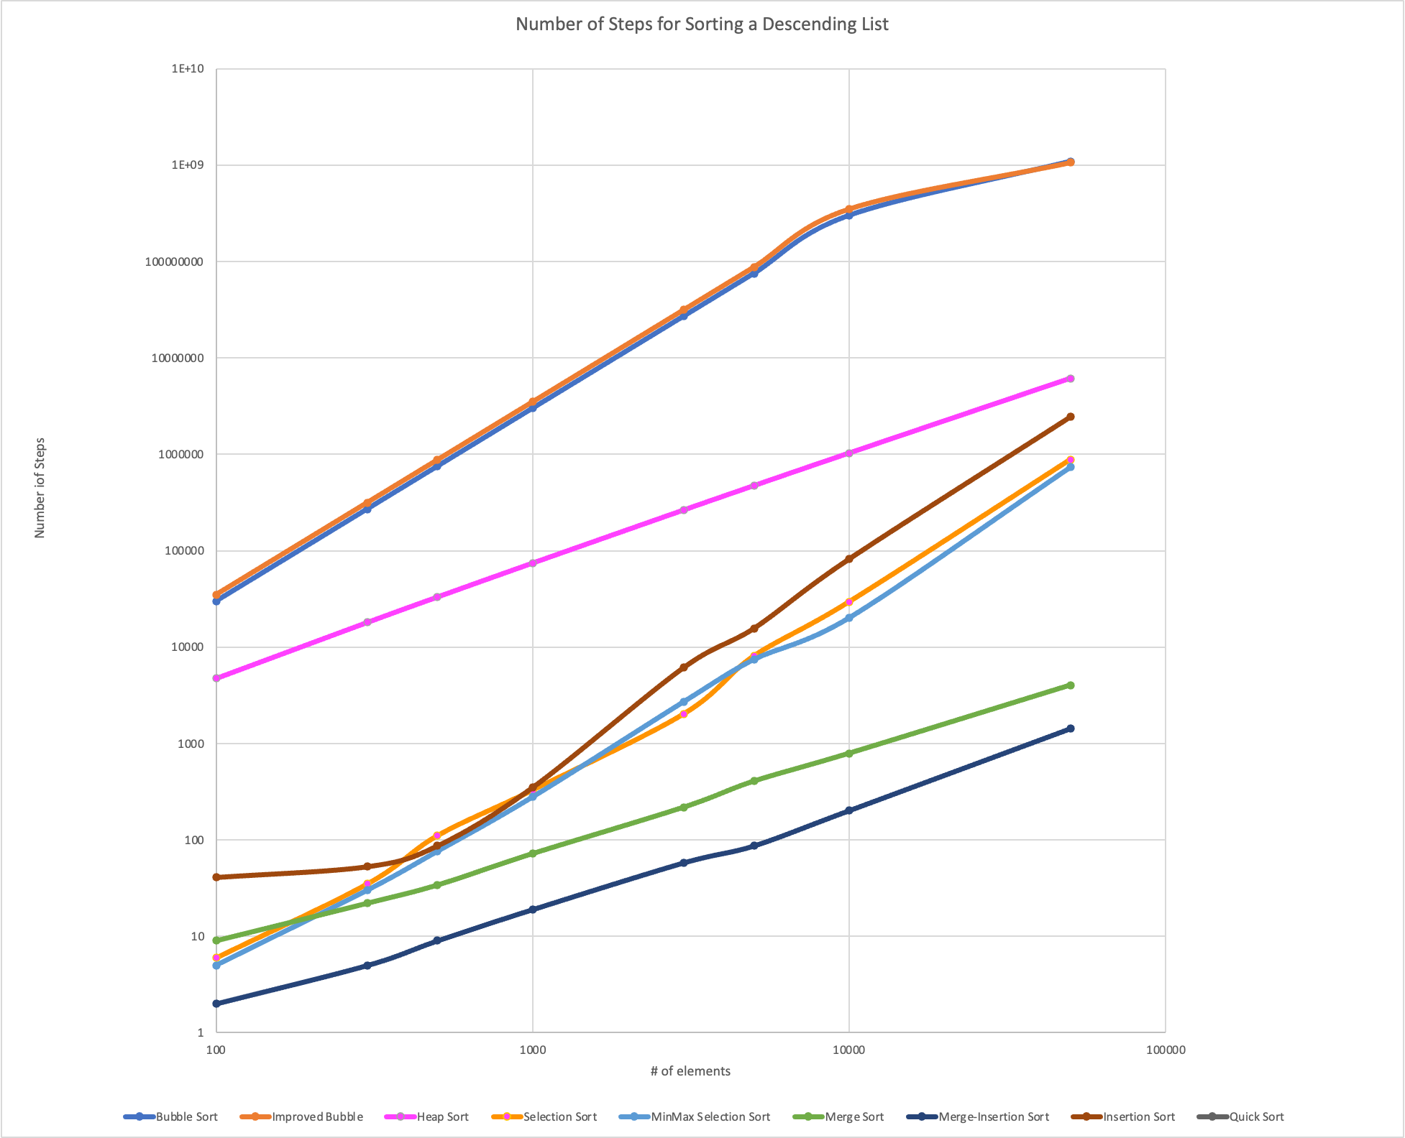
Task 1: Descending List

Slide 22
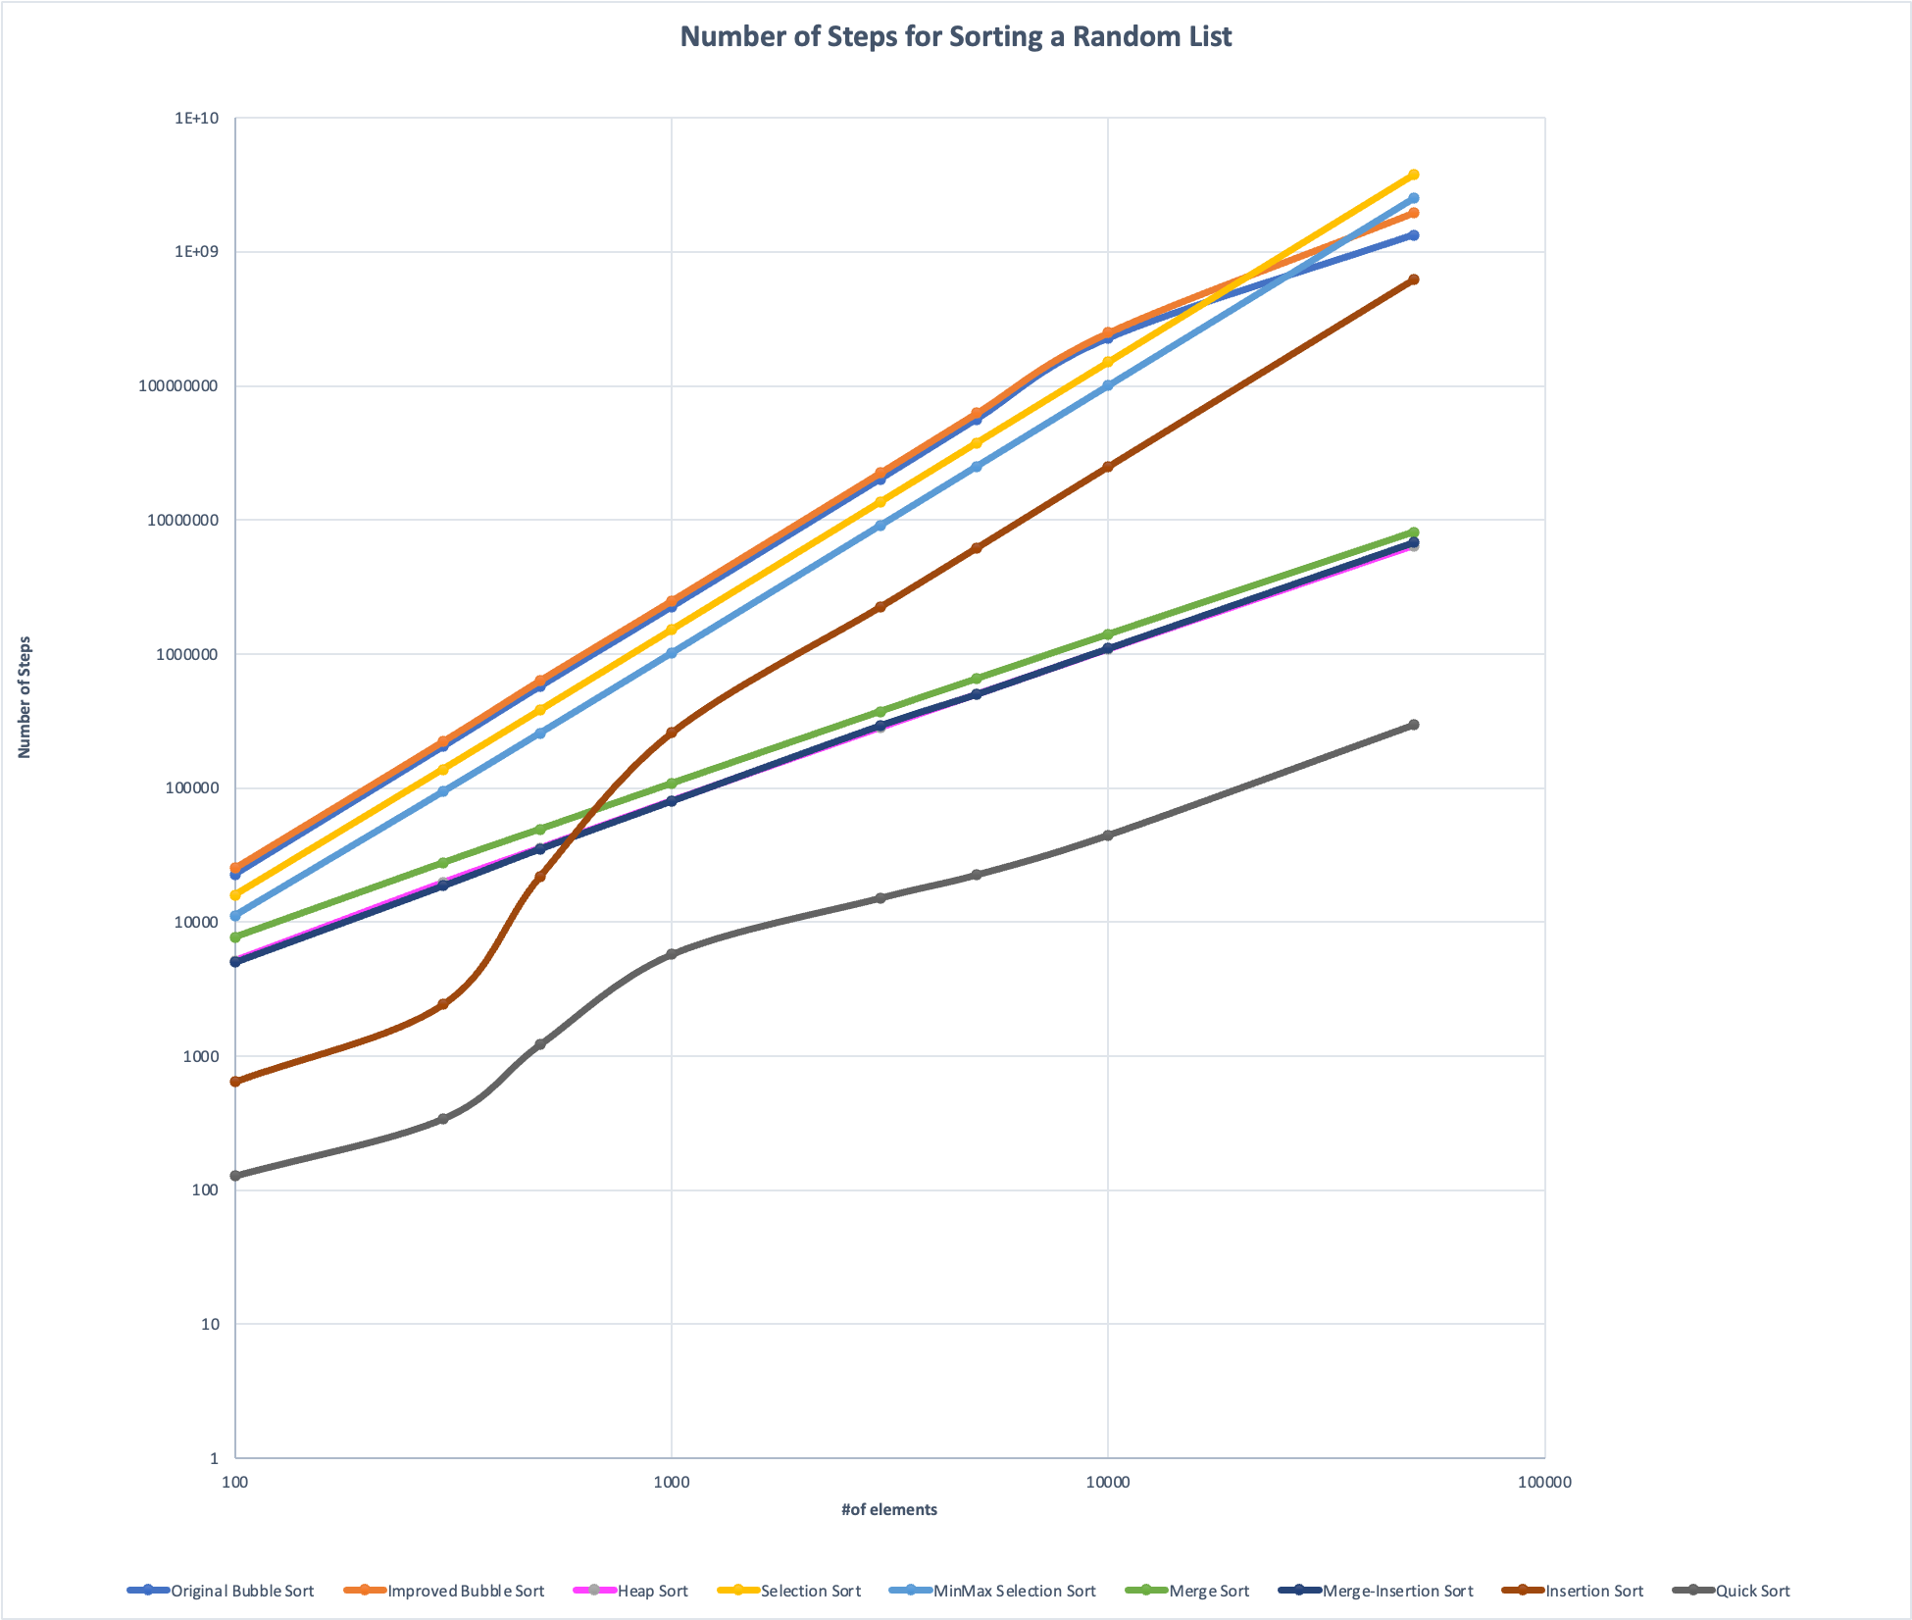
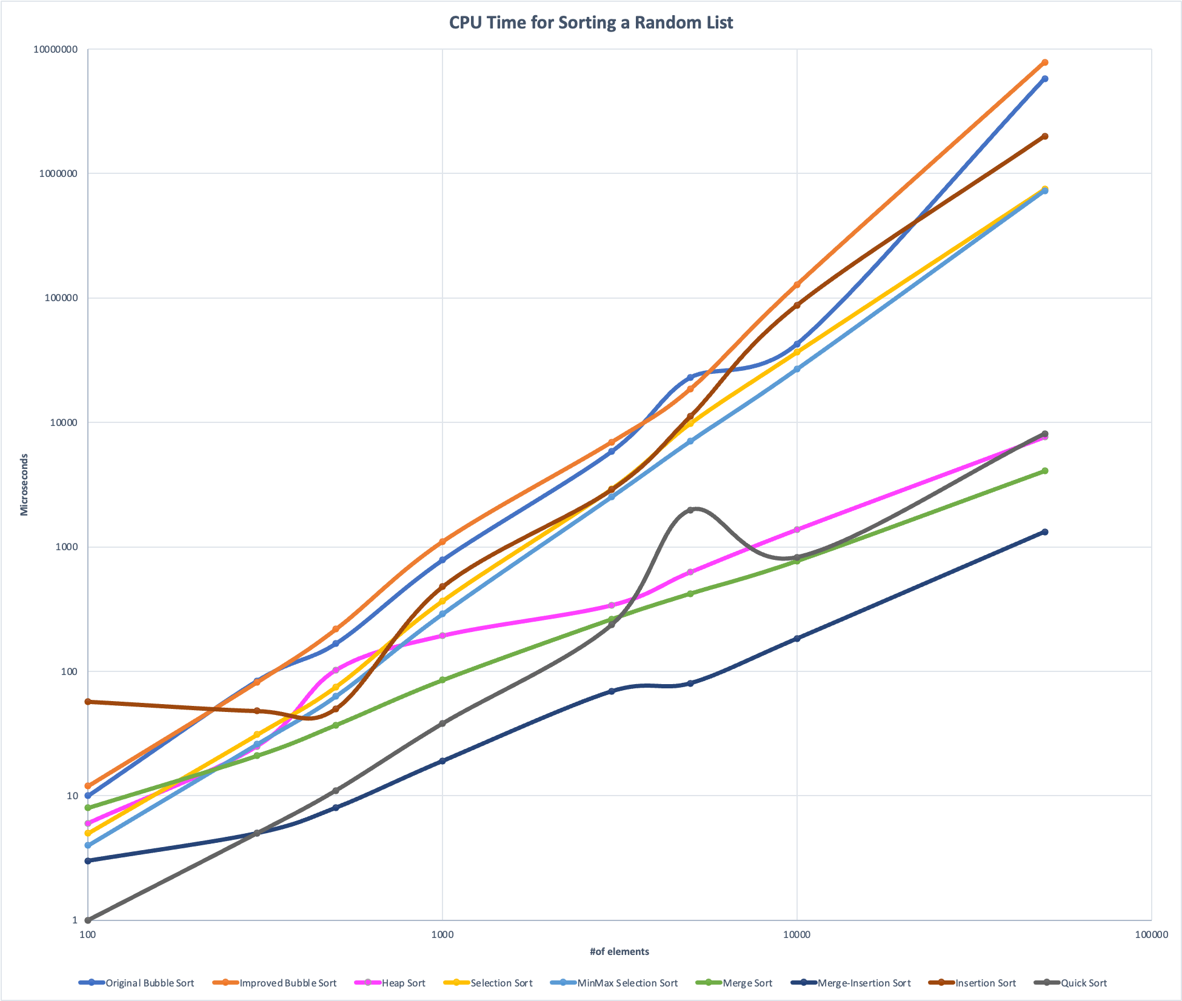
Task 1: Random Order List

Slide 23
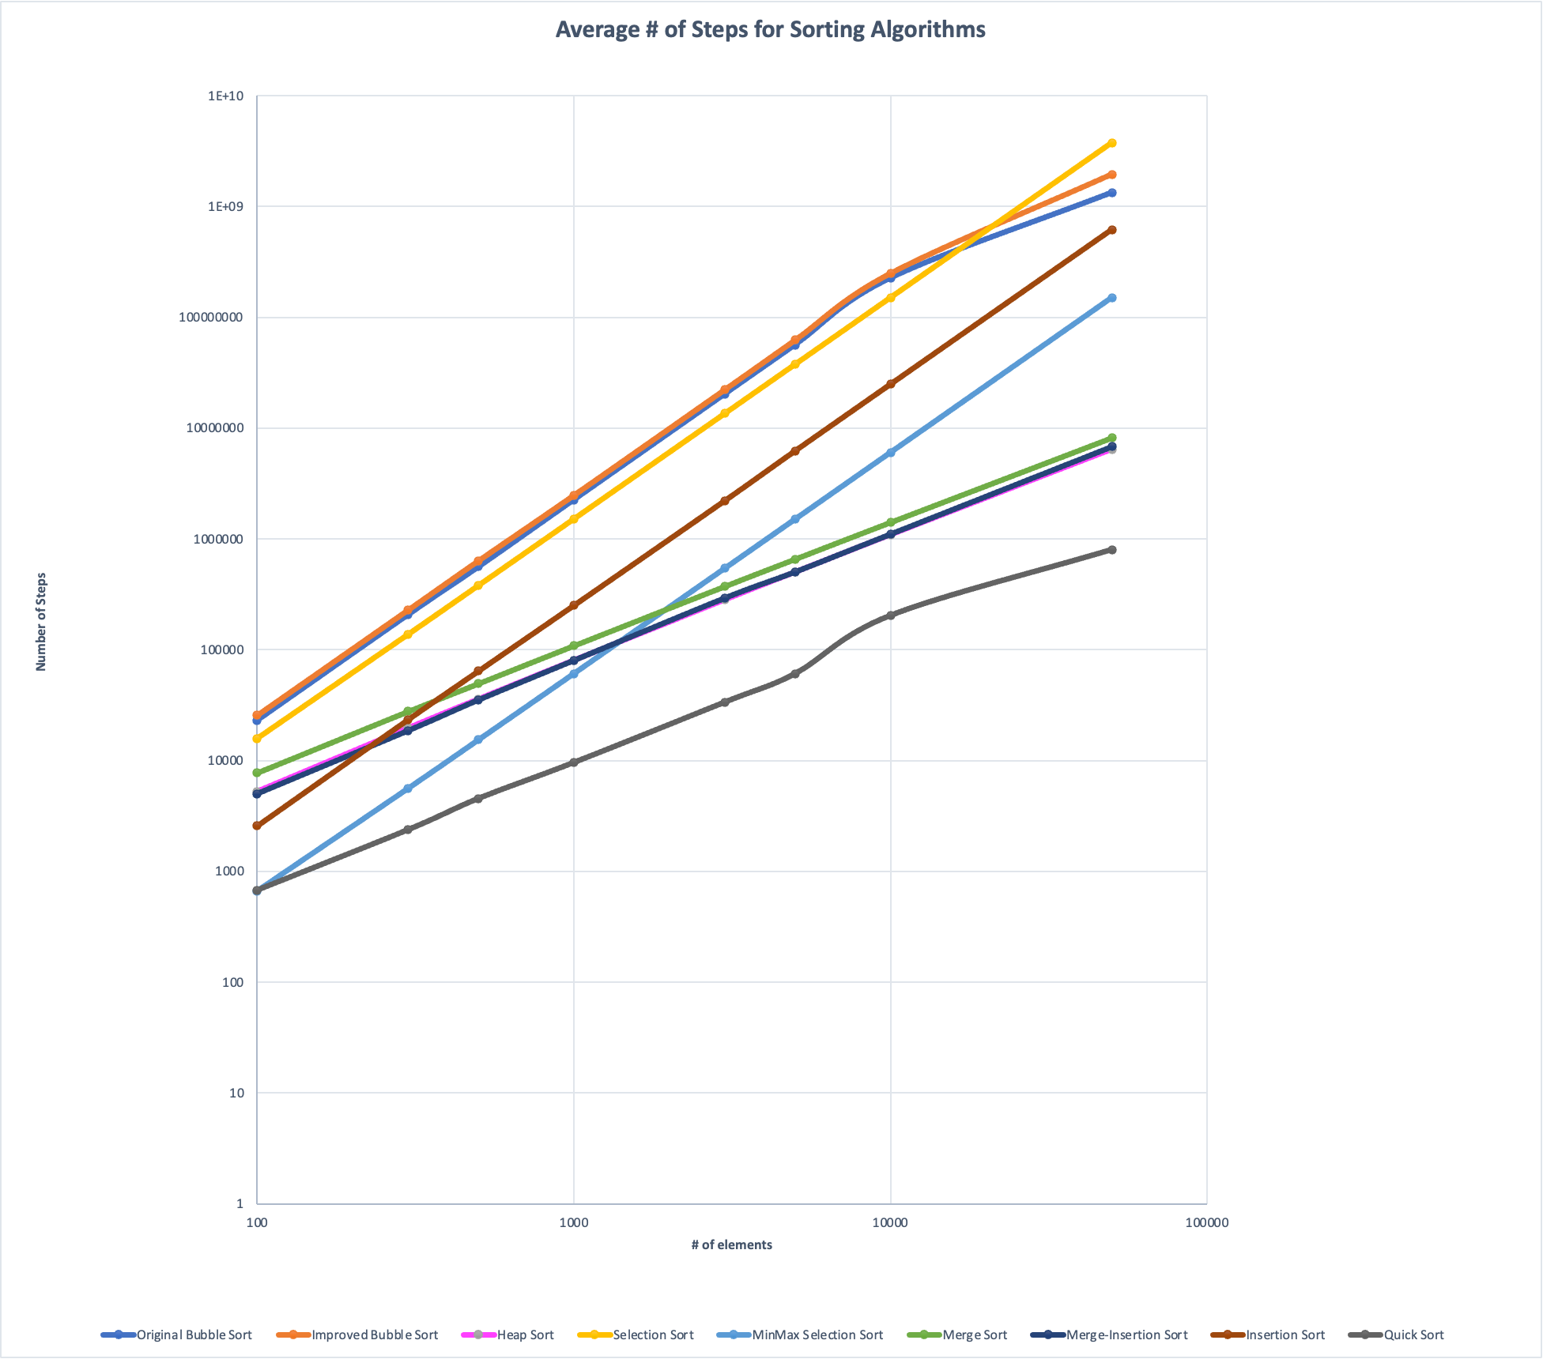
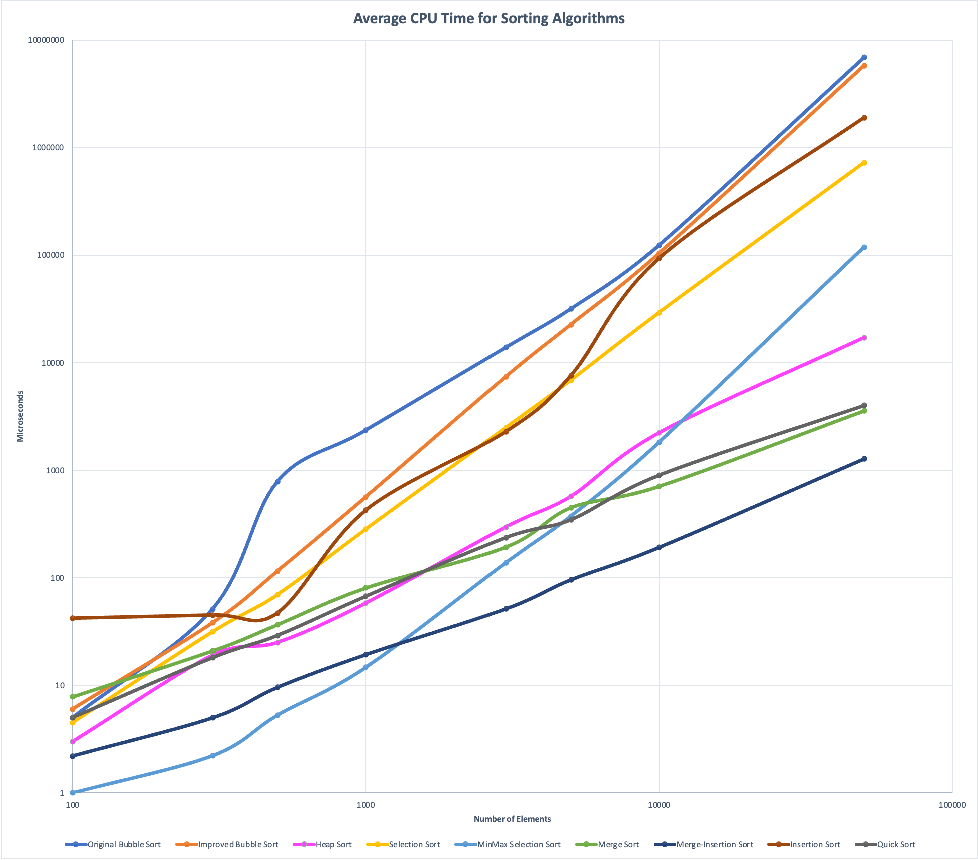
Task 2: Average Values

Slide 24
Appendix
Data Collected, tables showcased by corresponding color. This will be the excel sheet that we used
Task 1:
Ascending List
Descending List
Random Permutation
Task 2:
Average Run and # of Steps
Link to Excel Spreadsheet

